Slide 1
Social Capital and Knowledge Management in R&D Coopetitive Context: The case of a “Severo Ochoa Centre of Excellence”
XII INTERNATIONAL WORKSHOP ON HUMAN RESOURCE MANAGEMENT
Daniel Dorta-Afonso
Claudia Benítez-Núñez
José Luis Ballesteros-Rodríguez
Nieves Lidia Díaz-Díaz
Petra de Saá-Pérez

Slide 2
INTRODUCTION
Severo Ochoa Centers of Excellence
Recognition by the Spanish government
R&D institution that are examples of the quality and relevance of research in Spain
Leading-edge Research Programs
International competitive Human Resource Program
Coopetitive Capability
The ability to manage tensions derived from the paradox of simultaneous cooperation and competition (Bengtsson et al., 2016)
CS INTERNO

Slide 3
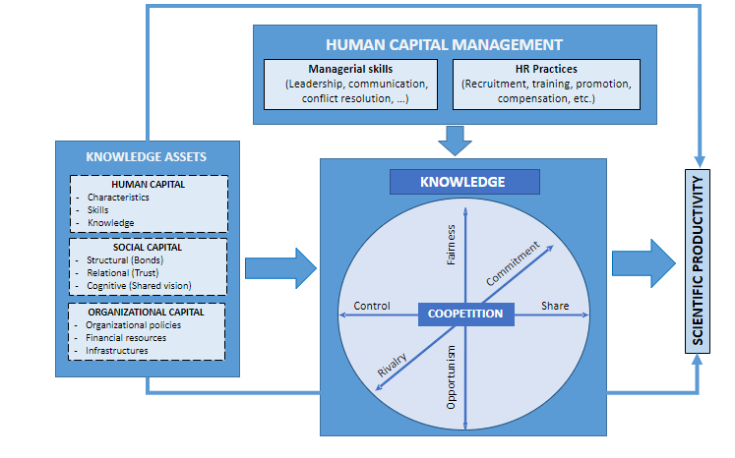
THEORY FRAMEWORK

Slide 4
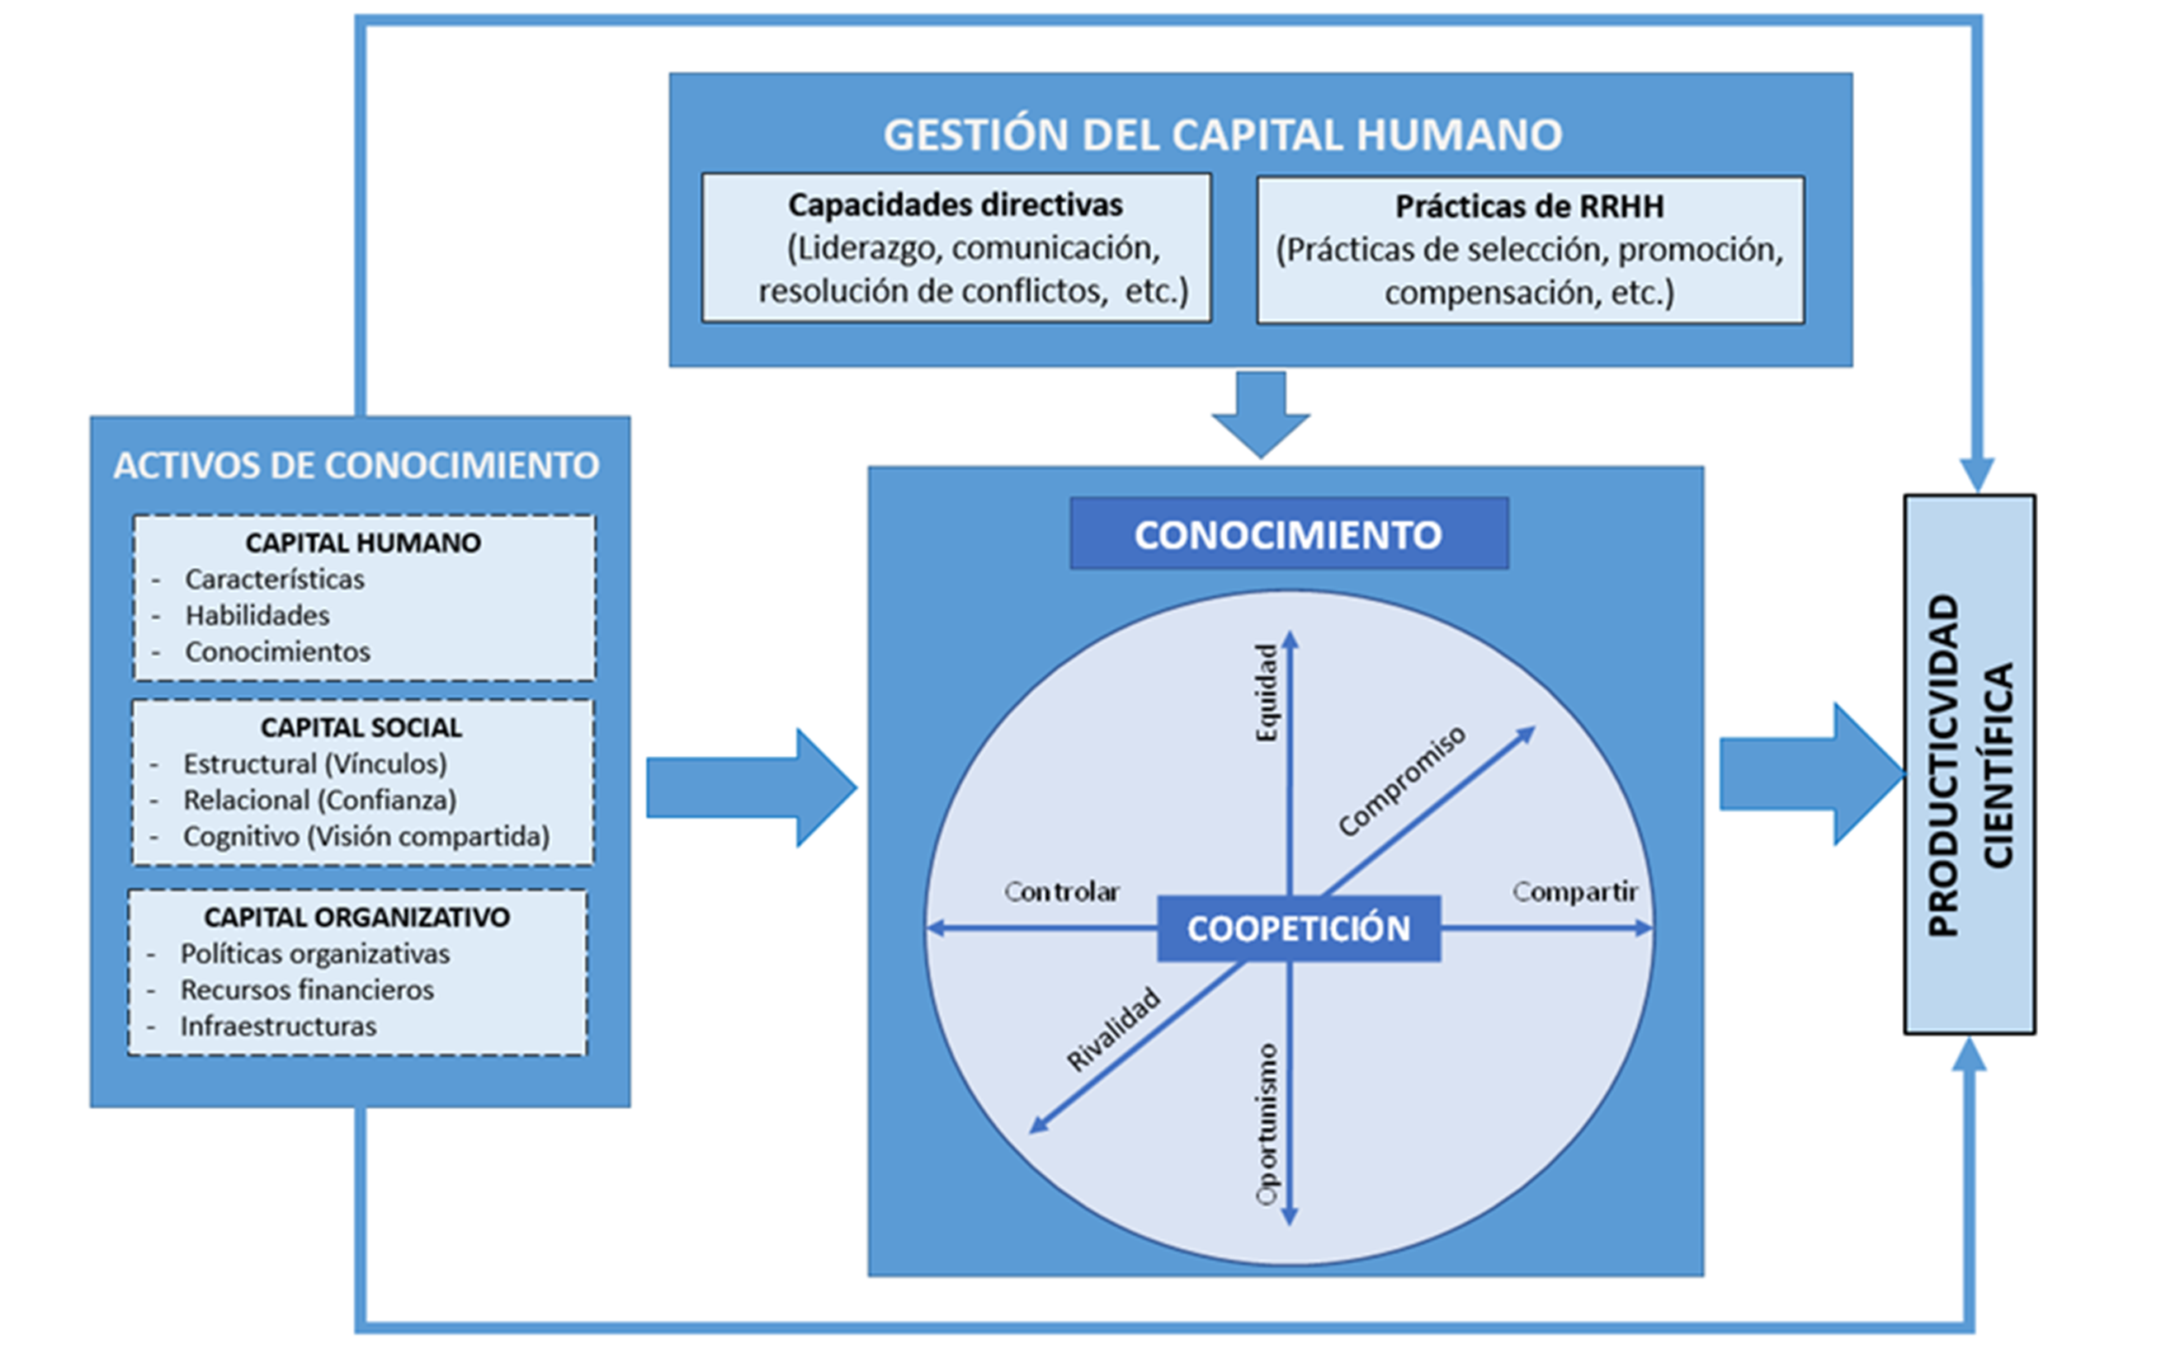
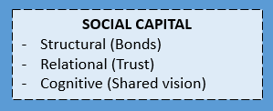
THEORY FRAMEWORK
Social capital is defined as ‘’the sum of the actual and potential resources embedded within, available through, and derived from the network of relationships possessed by an individual or social unit” (Nahapiet & Goshal, 1998). These networks allow the combination of knowledge and skills to create new knowledge (De Frutos-Belizón et al., 2019)
SOCIAL CAPITAL IN COOPETITION
Structural dimension: Strong ties increases knowledge sharing (Hentonnen et al., 2014)
Relational dimension: Trust increases motivation to share knowledge and willingness to cooperate with competitors (Baruch & Lin, 2012; Chuang et al., 2016; Rouyre, 2021)
Cognitive dimension: Common language and vision can positively influence scientific performance (Benítez-Núñez et al., 2022)

Slide 5
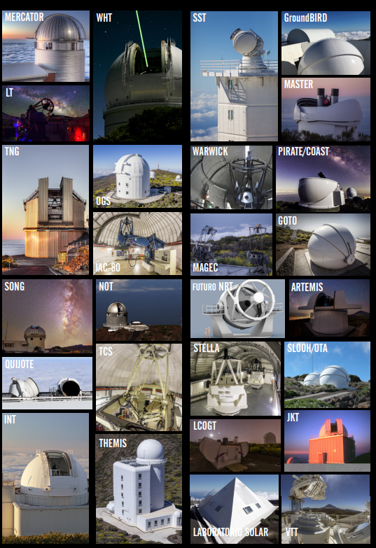
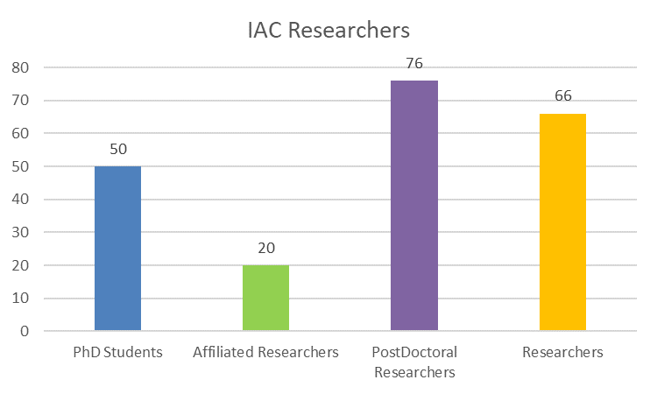
INSTITUTE OF ASTROPHYSICS OF CANARY ISLANDS (IAC) – A COOPETITIVE CONTEXT
56 telescopic facilities
22 partner countries
85 partner research centres
649 papers in 2021
212 researchers

Slide 6
PURPOSE
EXPLORE THE ROLE OF SOCIAL CAPITAL TO MANAGE THE PARADOX OF COOPETITION

Slide 7
METHOD. DATA COLLECTION
Interviewees
20
Number of interviews
34
Recorded Material
21h 48min
IN DEPTH INTERVIEWS
Category | Sample | Total Duration
Managers and Coordinators | 5 | 11h 13min
Severo Ochoa Research Line Coordinator | 6 | 4h 09min
Principal Investigators | 8 | 06h 26min
Participants
25
Number of Focus Groups
4
Recorded Material
5h 52min
FOCUS GROUPS
Researchers | Sample | Total Duration
Post-doctoral researchers | 9 | 1h 18min
International Post-doctoral researchers | 5 | 2h 09min
PhD Candidates | 4 | 1h 17min
Female researchers from all categories | 7 | 1h 08min

Slide 8
METHOD. DATA CODING
Software: NVIVO → for transcripts and codification of recorded material
Four coders: once agreement was reached, a single coder was in charge of coding all the Social Capital related material

Slide 9
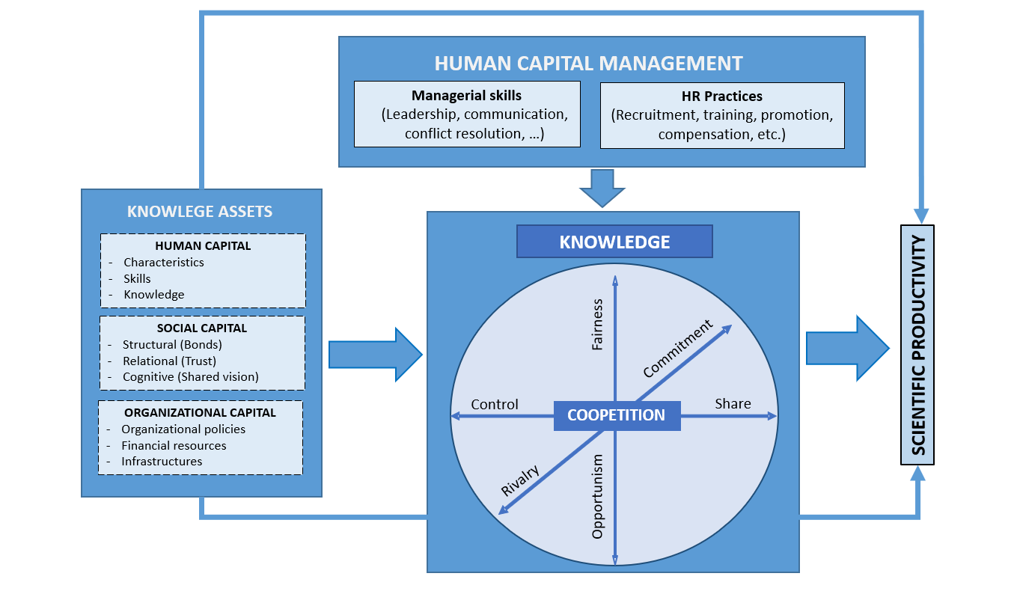
RESULTS
Common research interests
“It is a thing of scientific common interests. Someone tells you that (s)he has interest on doing something, and you also are interested on that. Thus, you just join efforts and work together”. Principal Investigator
Need of new knowledge
ANTECEDENTS
Methodology and research interest
New knowledge and instruments
Application for financial resources
“I collaborate with people from all over the world: India, Australia, Hungary, USA,…Italy. It depends on what you need, for example I collaborate a lot with theorists”. Principal Investigator
Application for financial resources
“In my group, we have plenty of international collaborators. To ask for funding, you normally look for colleagues in Spain, because they also benefit from that”. SO Line Coordinator

Slide 10
RESULTS
Team Size
“In those meetings we share a lot of knowledge. I thik this works in small groups. Our group is big but not so big. If it was much bigger we could not even be in a table looking to each other. ”. Principal investigator
Personality
“We are very different, but we complement each other. We have been working together for many years. It is like marriage, it can work well, or it can work badly. It is a matter of personality”. Principal investigator
COOPETITIVE CAPABILITY
ANTECEDENTS
Methodology and research interest
New knowledge and instruments
Application for financial resources
SC Barriers SC Facilitators
SO Structure
RESEARCHER | RESEARCH TEAM | IAC
Personality | Team size | SO Structure
Autonomy | Team leader | Committees
Pandemic, Technology, Networking, Mobility, Job Insecurity, Law
“I coordinate both parts of the line. So I am actually trying to look for interaction possibilities with the other side. I think there could be some possibilities to collaborate with them. ”. SO Line Coordinator
Team Leader
“I apply for funding for international mobility purposes. I like moving my people. We really need to take care of our contacts”. Principal investigator

Slide 11
RESULTS
Knowledge-related outcomes: knowledge acquisition
“If I need something and I do not have the expertise for that, who in IAC knows about that? I know everyone, every group, I know what everybody does, what everybody knows. Therefore, you know who you can reach and ask for help.” Principal Investigator
COOPETITION CAPABILITY
Productivity: more papers
ANTECEDENTS
Methodology and research interest
New knowledge and instruments
Application for financial resources
OUTCOMES
Knowledge-related outcomes
Productivity: more papers, merits for promotions and financial resources
Human capital: attract talent and more effective recruitment
SC Barrier SC Facilitators
“A conversation can result into a paper. Because that person has what you need. For example, someone has a theoretical model so that I can read my data. So, we collaborate and write a paper together.” Principal Investigator
RESEARCHER | RESEARCH TEAM | IAC
Personality | Team size | SO Structure
Autonomy | Team leader | Committees
Pandemic, Technology, Networking, Mobility, Job Insecurity, Law
Human capital: attract talent
“Because you are in a big network, your job offer reaches a lot of people”. SO Line Coordinator

Slide 12
RESULTS
COOPETITIVE CAPABILITY
ANTECEDENTS
Methodology and research interest
New knowledge and instruments
Application for financial resources
OUTCOMES
Knowledge-related outcomes
Productivity: more papers, merits for promotions and financial resources
Human capital: attract talent and more effective recruitment
ANTECEDENTS
Methodology and research interest
New knowledge and instruments
Application for financial resources
SC Barriers SC Facilitators
RESEARCHER | RESEARCH TEAM | IAC
Personality | Team size | SO Structure
Autonomy | Team leader | Committees
Pandemic, Technology, Networking, Mobility, Job Insecurity, Law

Slide 13
CONCLUSION AND NEXT STEPS

Slide 14
This work is part of the R&D&I project PID2020-114550GB-I00 funded by MCIN/AEI/ 10.13039/501100011033
Work co-financed by the Canary Agency for Research, Innovation and Information Society of the Regional Ministry of Economy, Knowledge and Employment and by the European Social Fund (ESF), Integrated Operational Program of the Canary Islands 2014-2020, Axis 3 Priority Theme 74 (85%)

